Slide 1
20 ICT ideas in
10 minutes

Slide 2
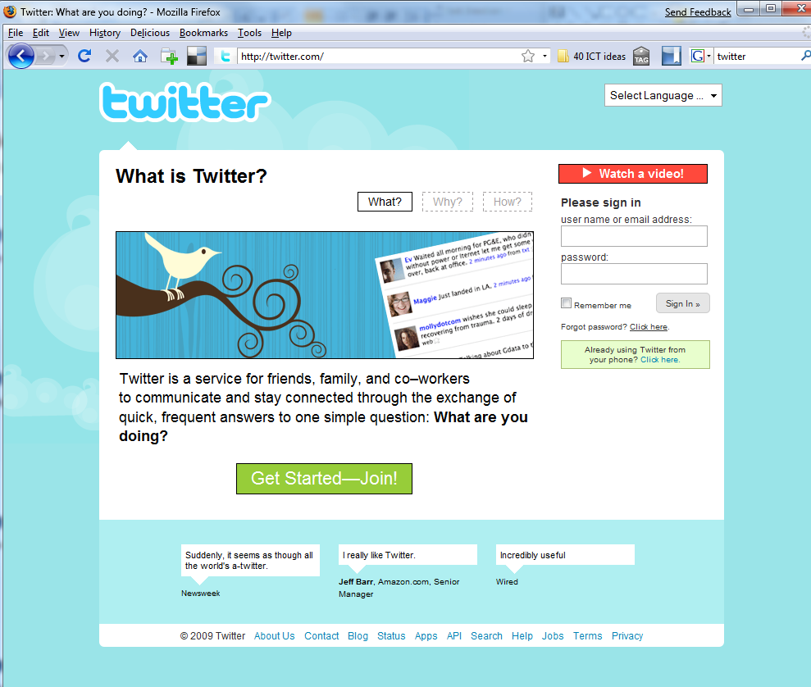
1

Slide 3
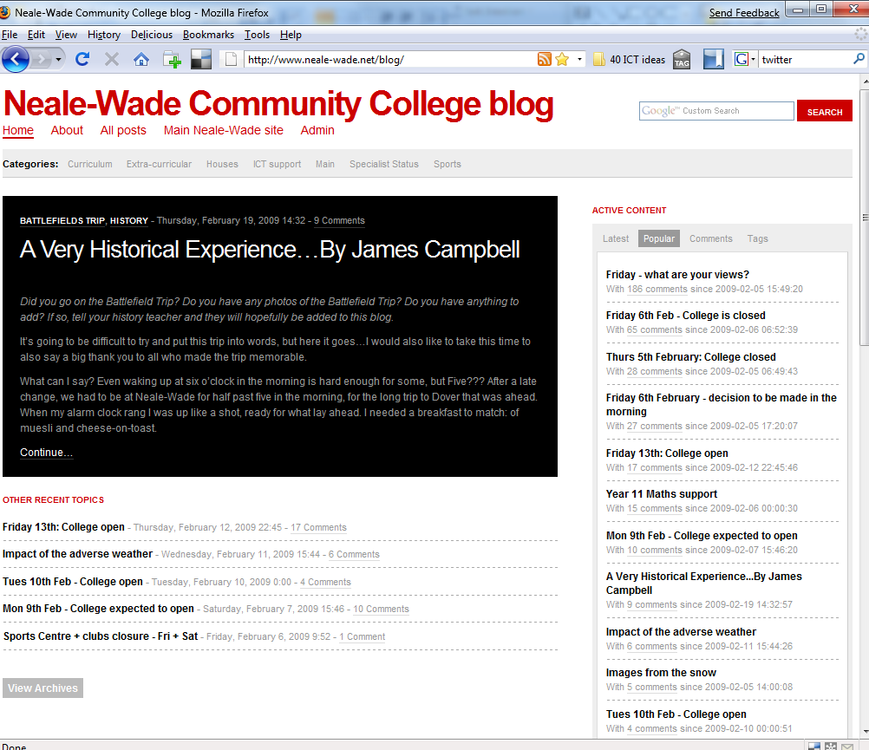
2

Slide 4
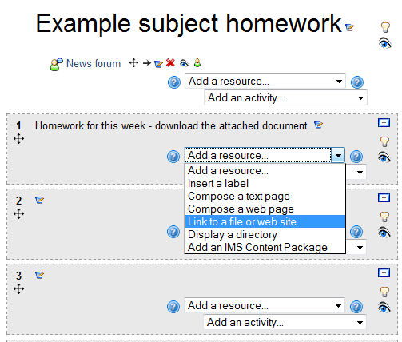
Upload homework to Moodle
3
http://www.nwvle.net

Slide 5
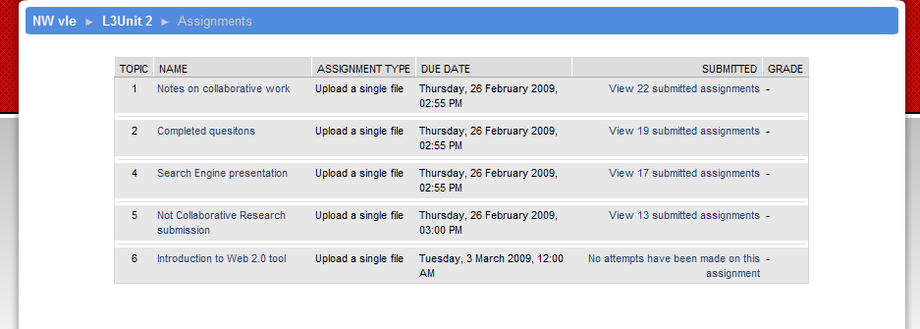
Submit work via Moodle
4
http://www.nwvle.net

Slide 6
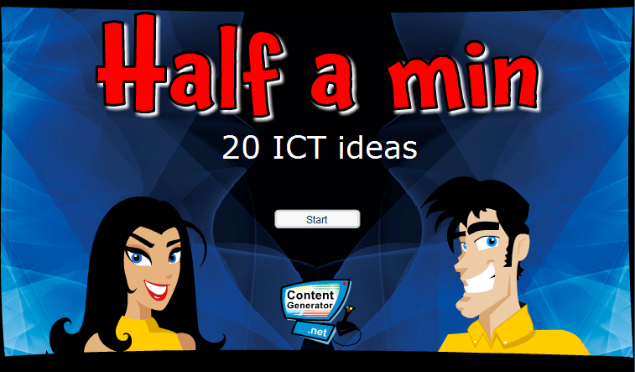
Generate a starter / plenary game
5
On school network +
http://www.contentgenerator.net

Slide 7
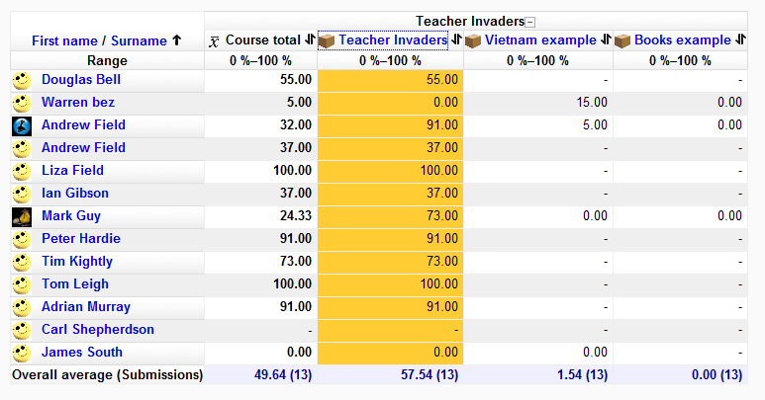

Track a learning game in Moodle
6
On school network +
http://www.contentgenerator.net + www.nwvle.net

Slide 8
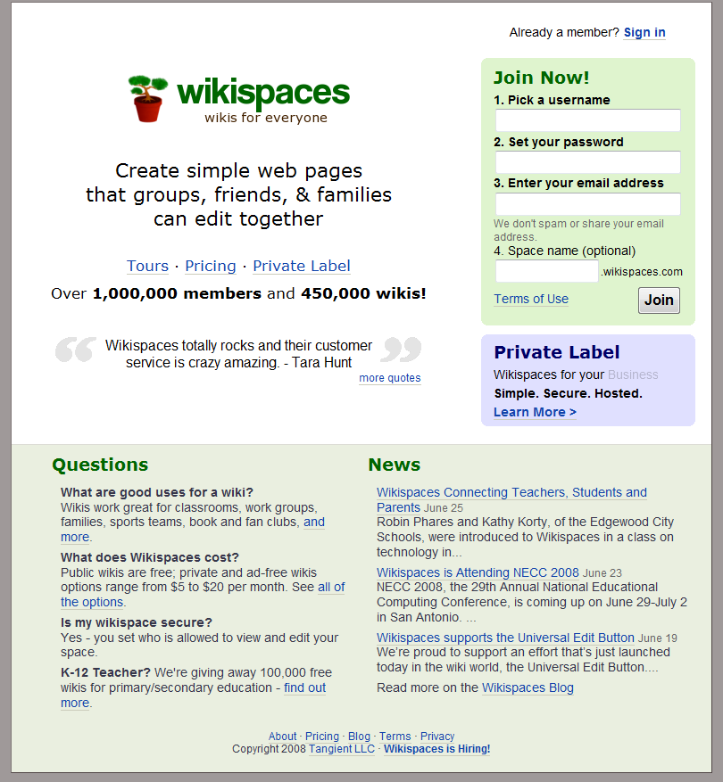
Setup a wiki
7
http://www.nwvle.net

Slide 9
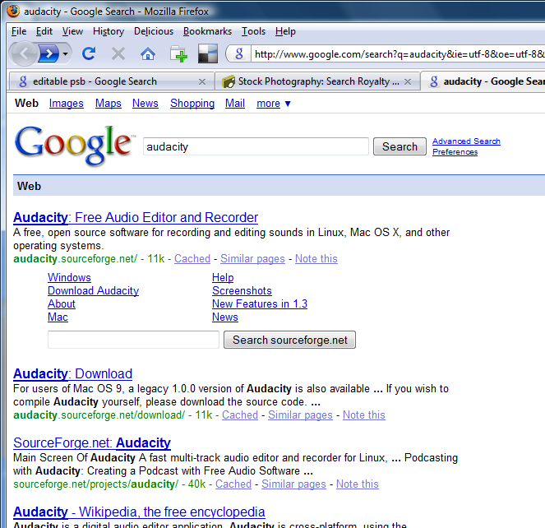
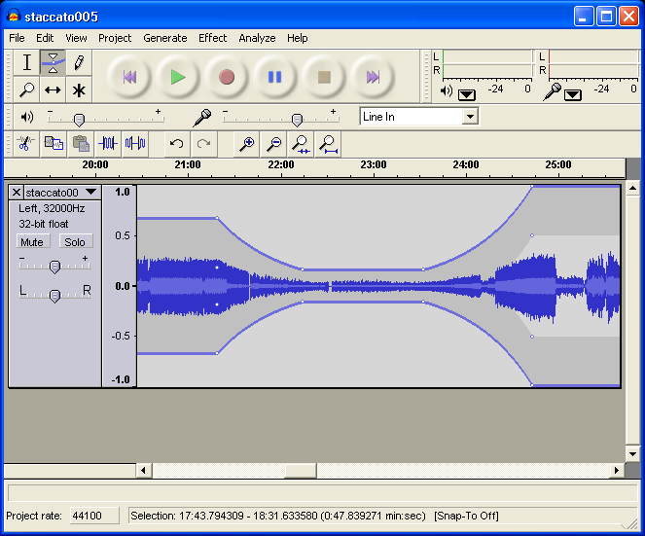
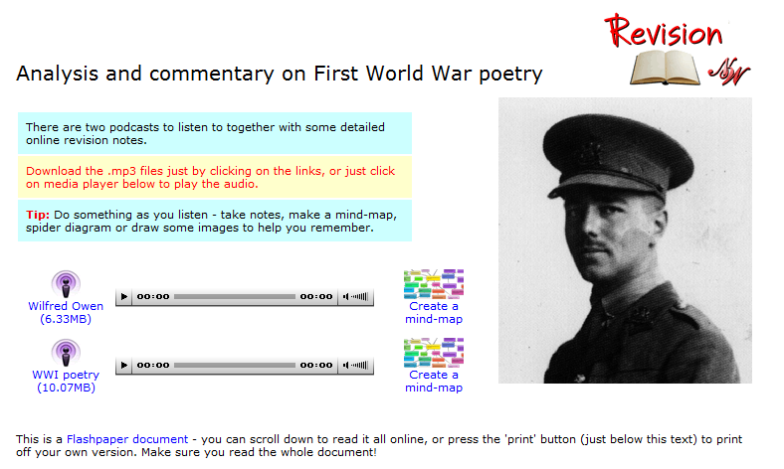
‘Podcasting’ / Audacity
8

Slide 10
Destroy PowerPoint
As few words
Relevant images
9

Slide 11
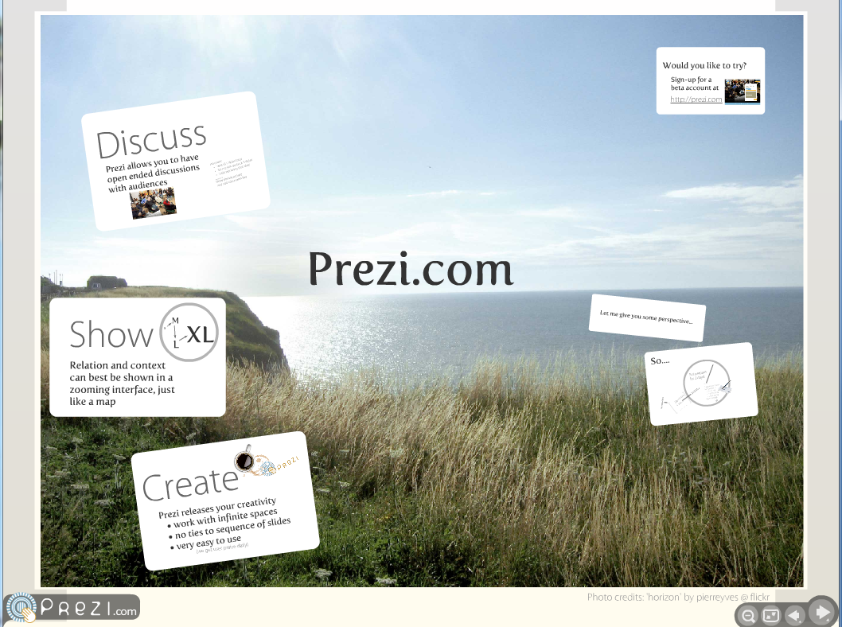
prezi.com
10

Slide 12
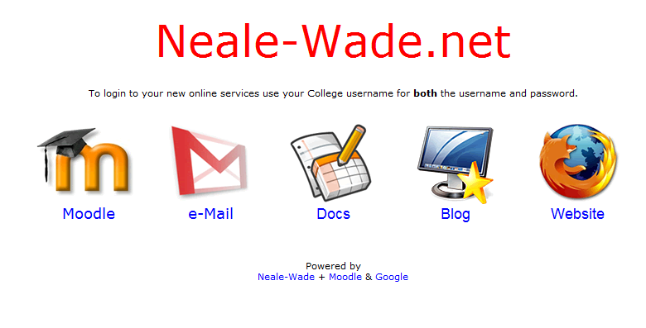
Google Apps
11
http://www.neale-wade.net

Slide 13
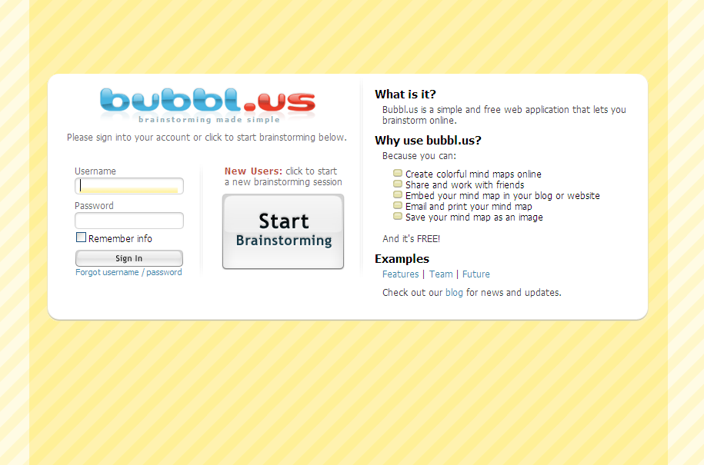
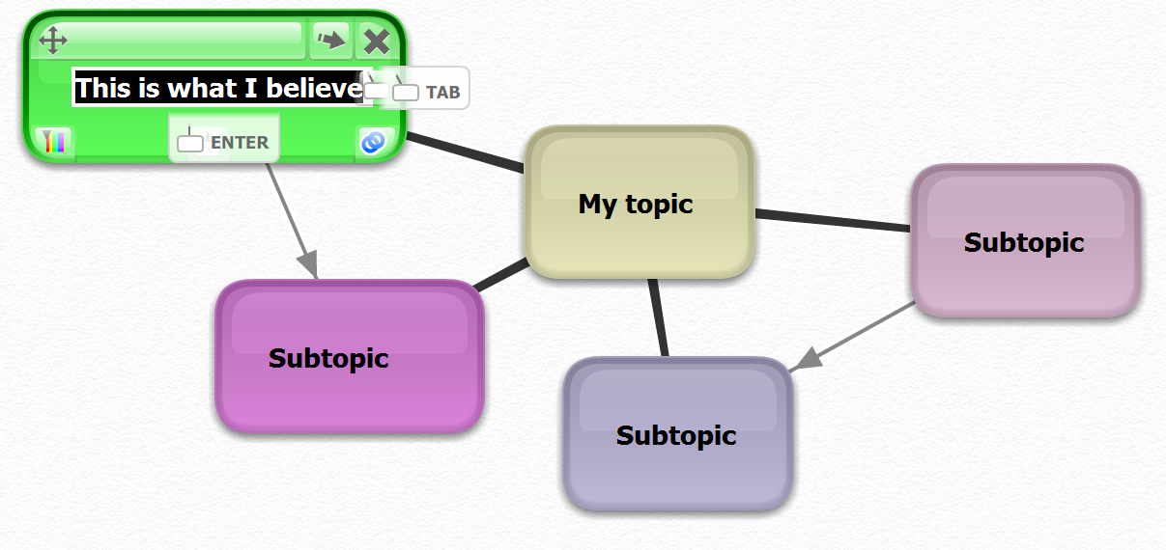
Bubbl.us
12

Slide 14
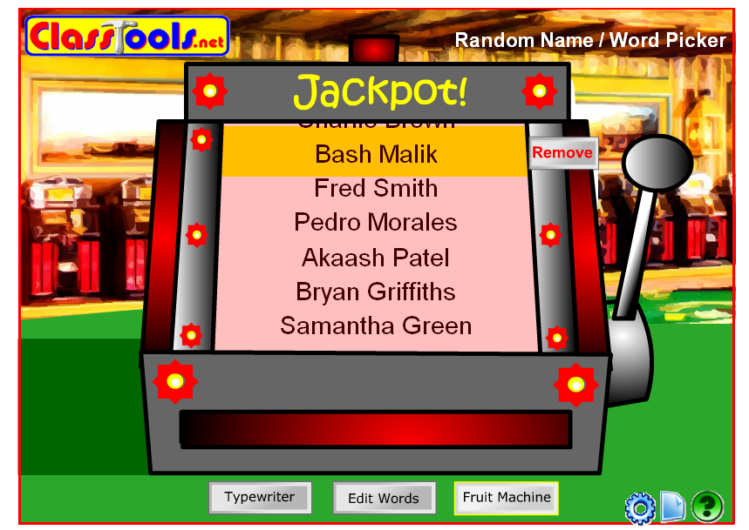
Random student selector
13

Slide 15
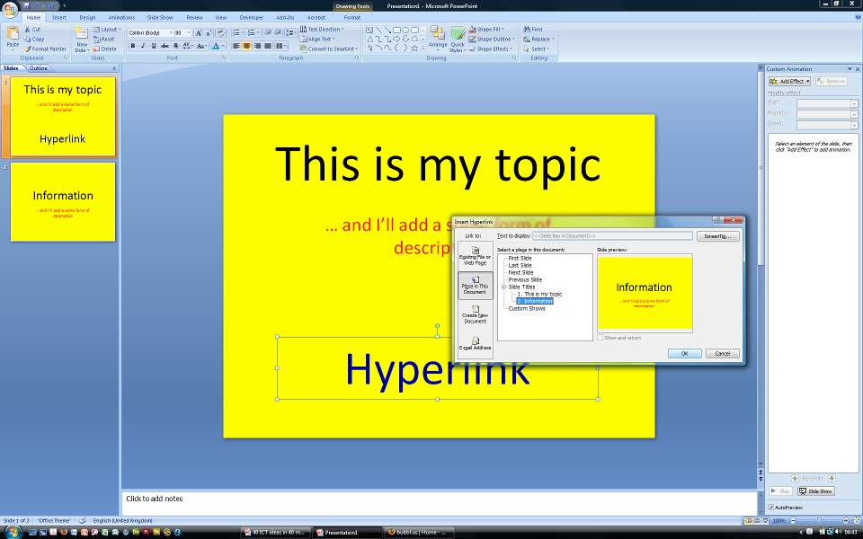
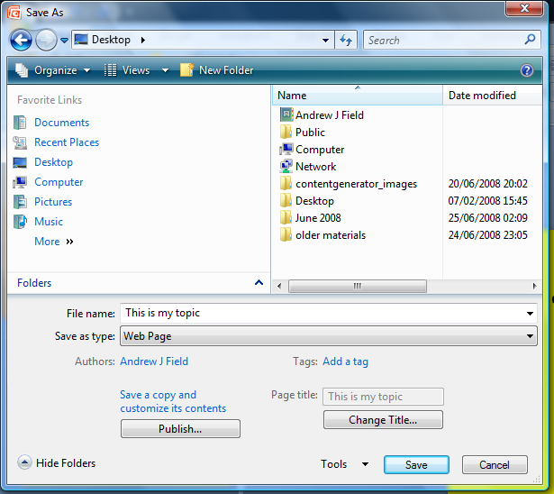
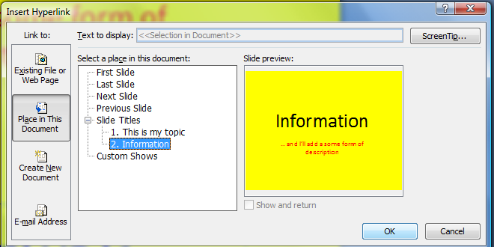
Create a website just in PowerPoint
14

Slide 16
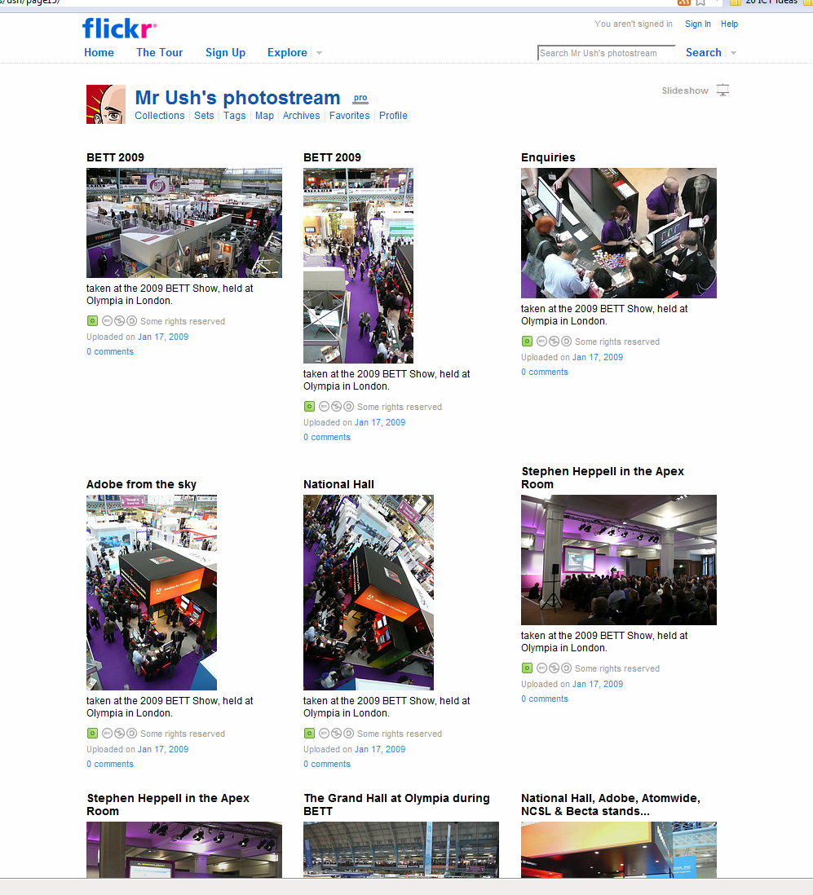
Flickr
15

Slide 17
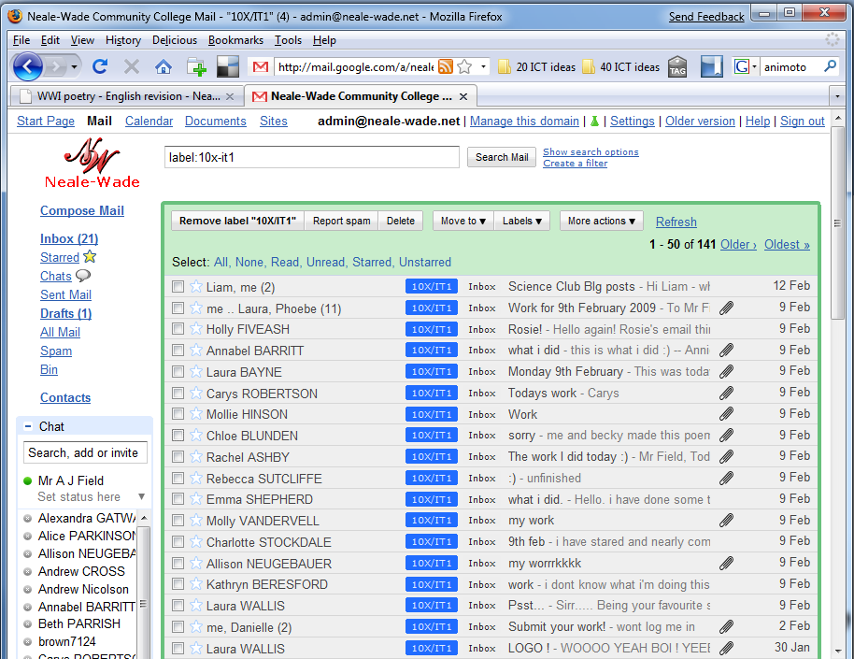
G-mail
16
http://www.neale-wade.net

Slide 18
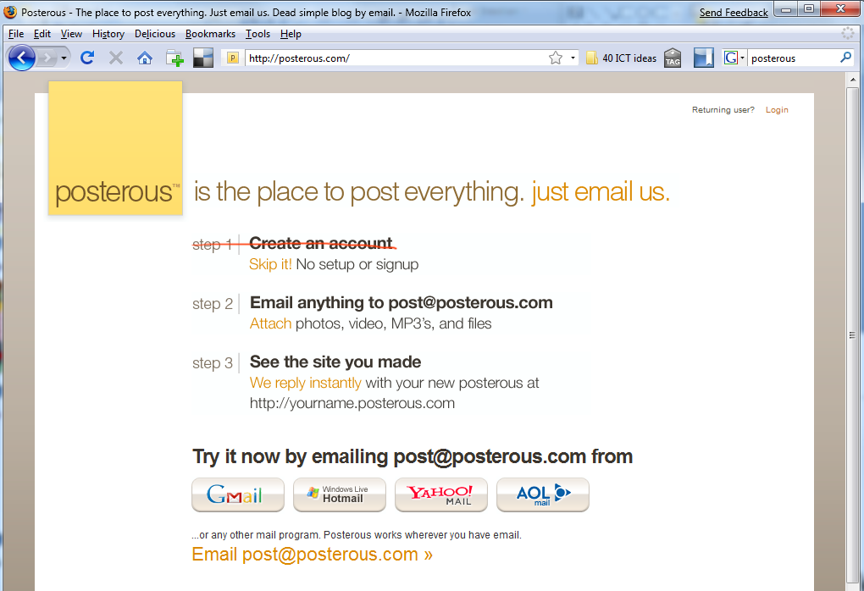
Posterous
17

Slide 19
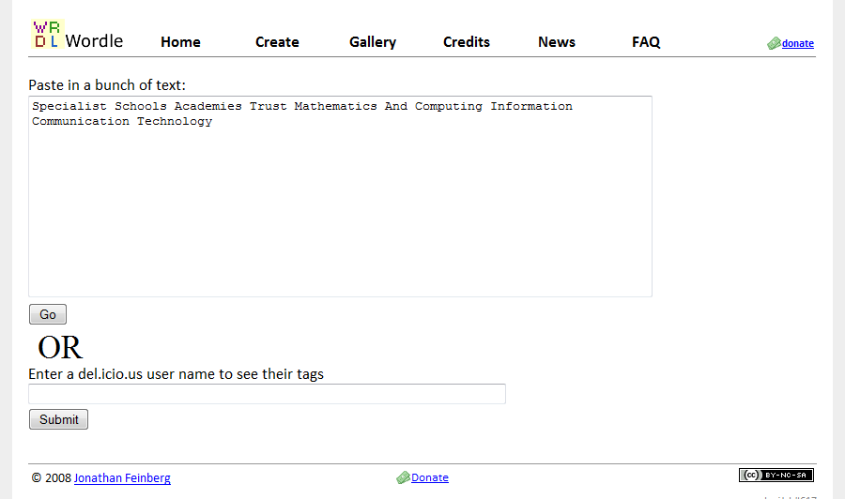

Wordle.net
18

Slide 20
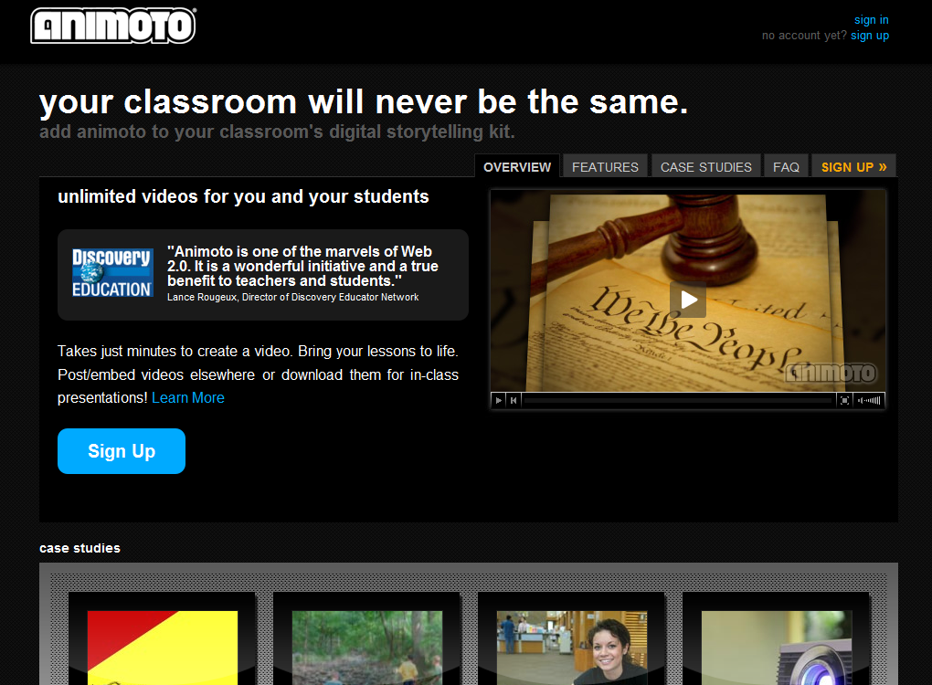
Animito
19

Slide 21
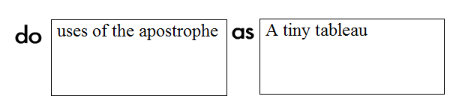

Random activity generator
20
http://www.newtools.org/showtxt.php?docid=737

