Slide 1


Presentation 3
11:30 – 12:00
Using ContentGenerator.net for enjoyable, automatic assessment in Moodle
Andrew Field
Head of ICT, Neale-Wade Community College

Slide 3





Slide 4
Background
Our websites –
  SchoolHistory.co.uk
  ReviseICT.co.uk
  MusicAtSchool.co.uk
Engaging students, grabbing attention
Interactive games
  ‘trick’ students into learning?

Slide 5


+
Engaging content
Interactive
Huge potential
  Positive: enthusiasm, design, whizz-bang!
  Negative: style over content?

Slide 6

Downloadable software
Generate your own custom activities
Produces custom .swf (Flash) file
No need for Flash authoring skills

Slide 7

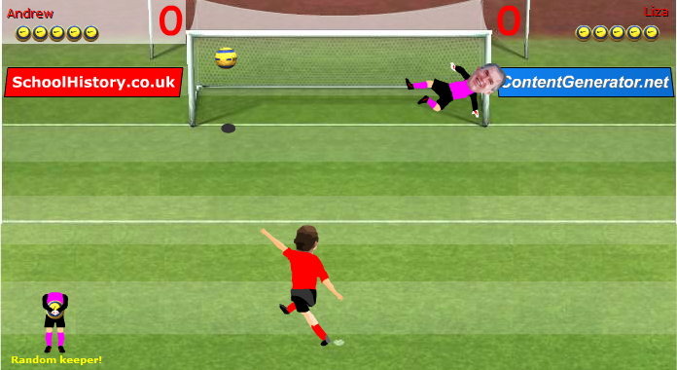
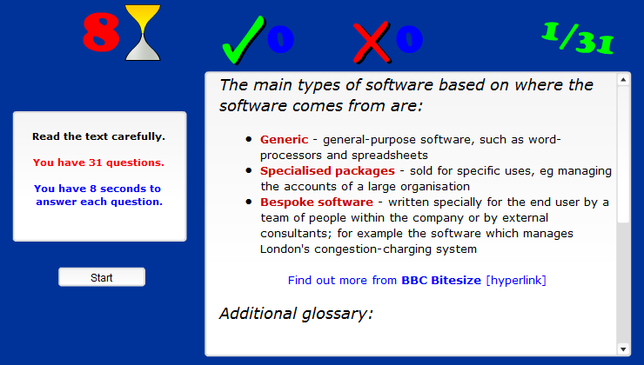
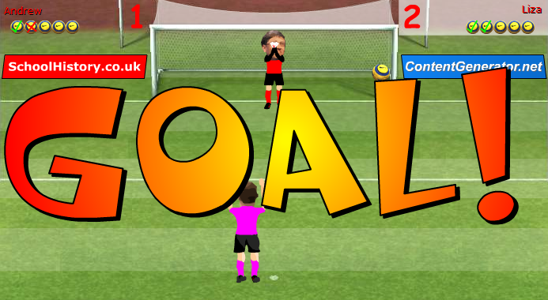
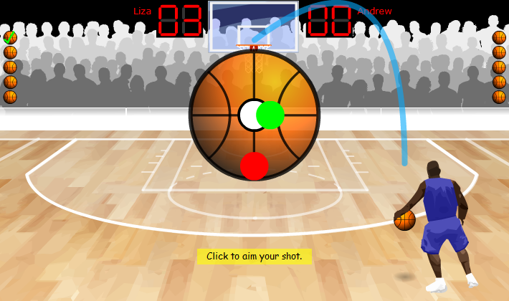
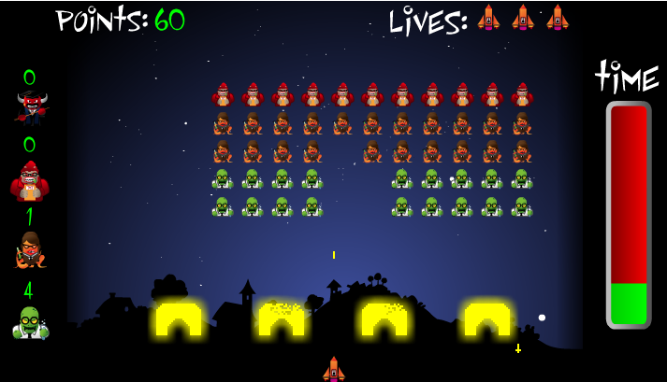
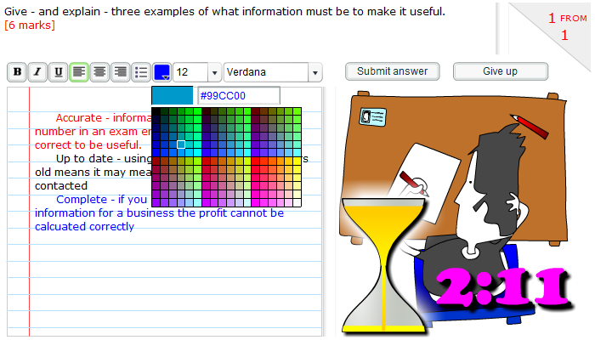
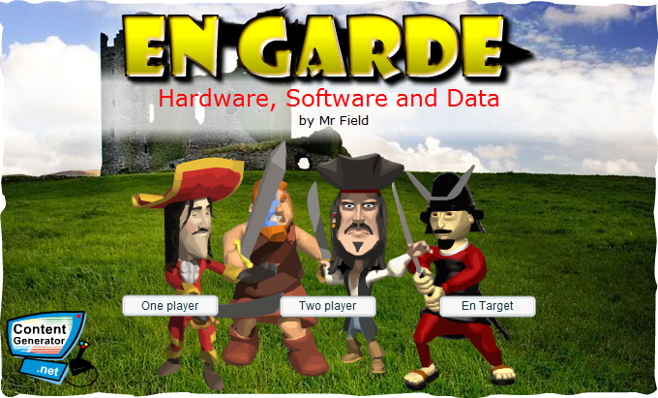
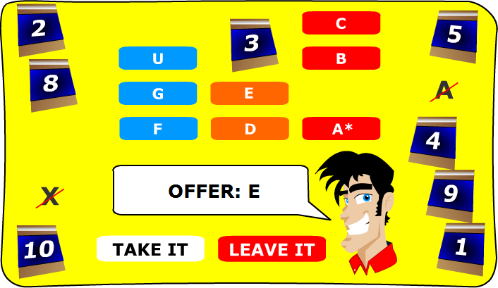
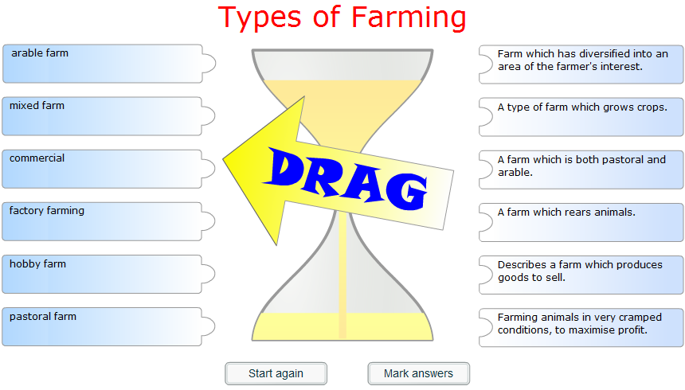
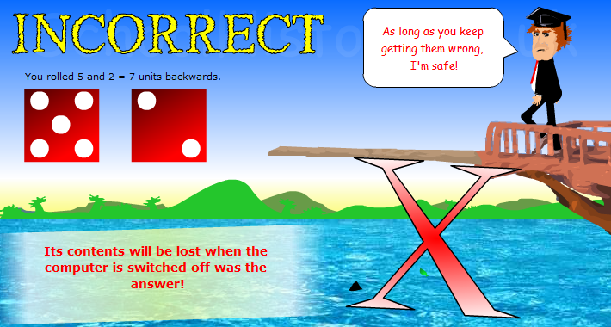
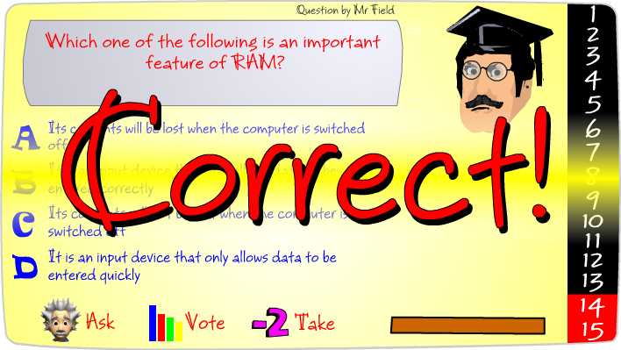
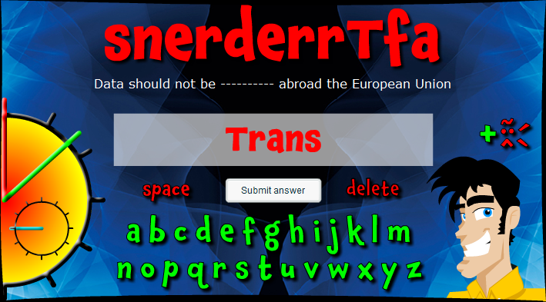
Examples

Slide 8
Usage of ContentGenerator.net
Ideal for starters and plenaries
Used by a huge number of teachers – over 13,500 registrations since 2004.
Range of entertaining games
  Competitive elements
  Joke violence / humiliation of teachers

Slide 9
Usage of ContentGenerator.net
Mostly low-level learning activities
Yet do slot in really well into Moodle just as an uploaded resource
  Praised by Mr Moodle himself
Possible higher level usage too
  students as authors
  revision & transition work

Slide 10
However...

Slide 11

S.C.O.R.M.
?
Sharable
Content
Object
Reference
Model

Slide 12
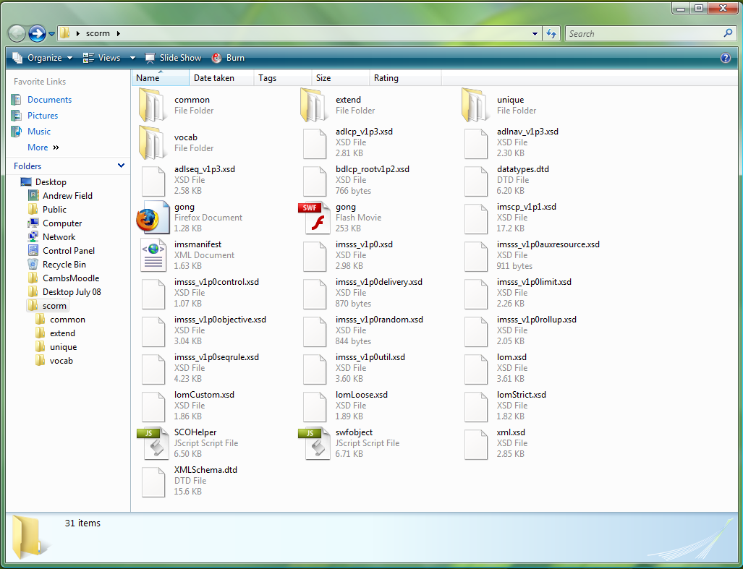
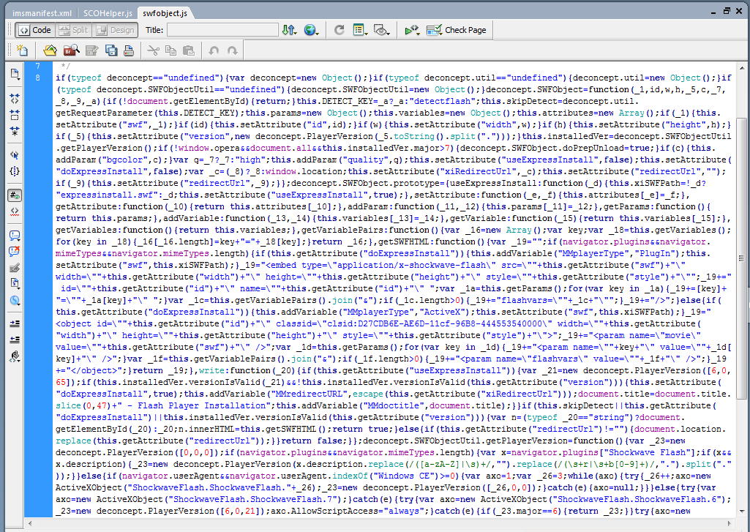
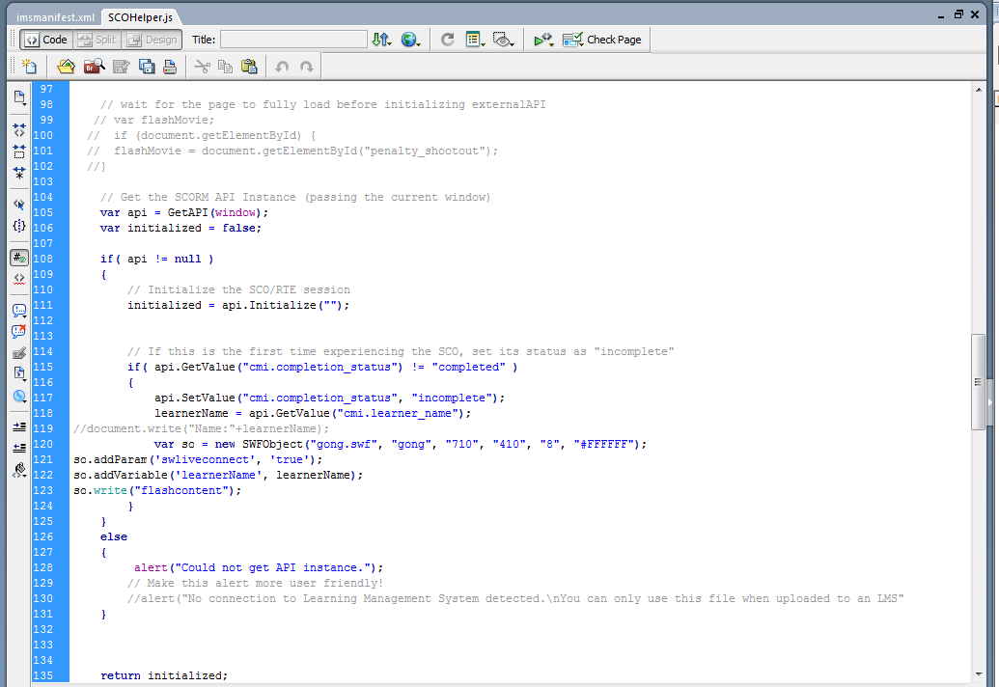
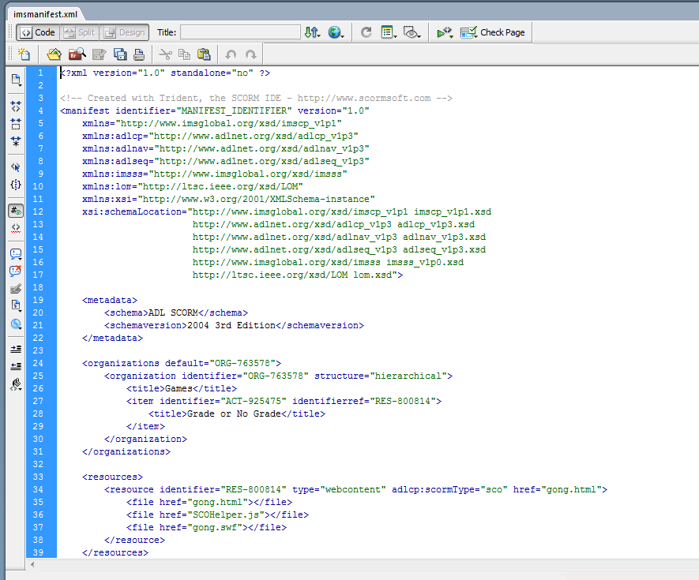
S.C.O.R.M.
Way to track e-Learning

Slide 13
S.C.O.R.M.
Way to track e-Learning

Slide 14
+
Tracking scores & usage
Key feature of Moodle
Huge potential
  Positive: tracking, AFL, student ownership
  Negative: complex, annoying & frustrating

Slide 15

(
)
+
+
(
)
+
=
+

Slide 16
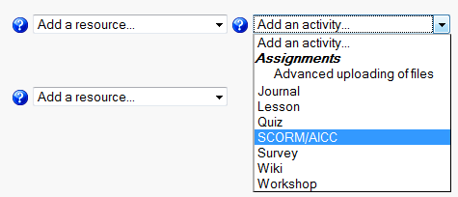
Generate SCORM automatically
New versions of programs generate:
  standard .swf (Flash) file
  or complex .zip SCORM package
Removes need to program SCORM
SCORM uploads via ‘Add an activity’ option

Slide 17
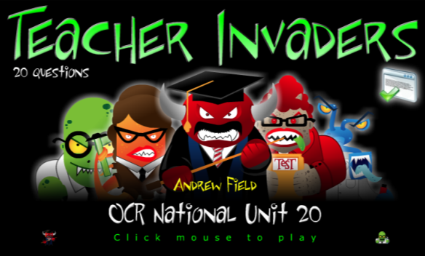
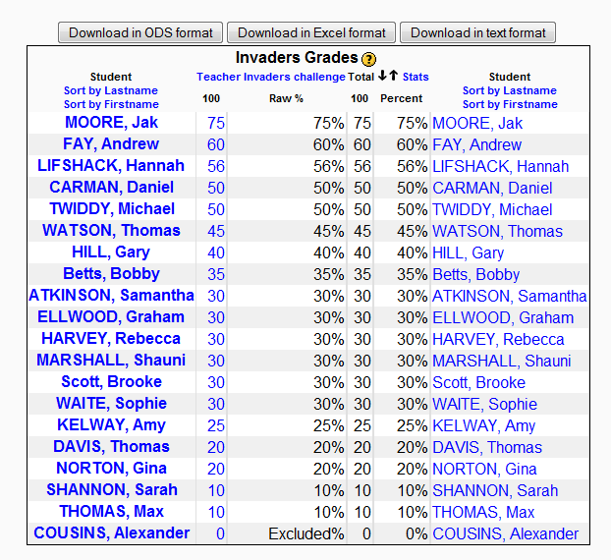
Moodle Gradebook
Surnames removed
Surnames removed

Slide 18
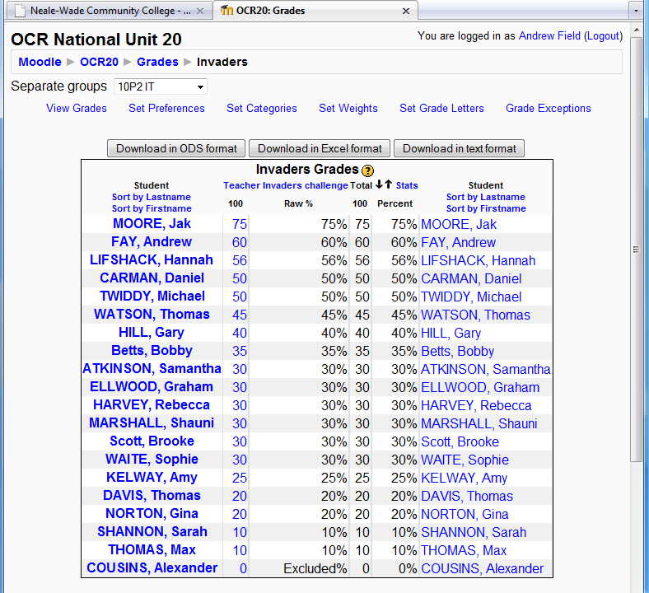

Slide 19
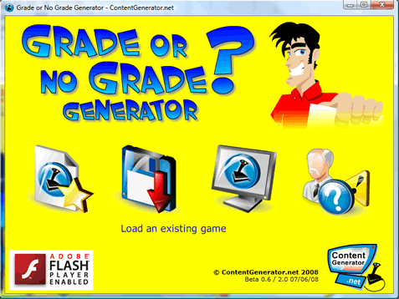
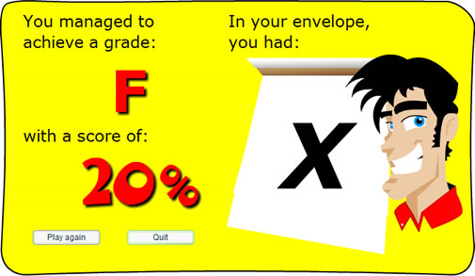
Standard game...
but...

Slide 20
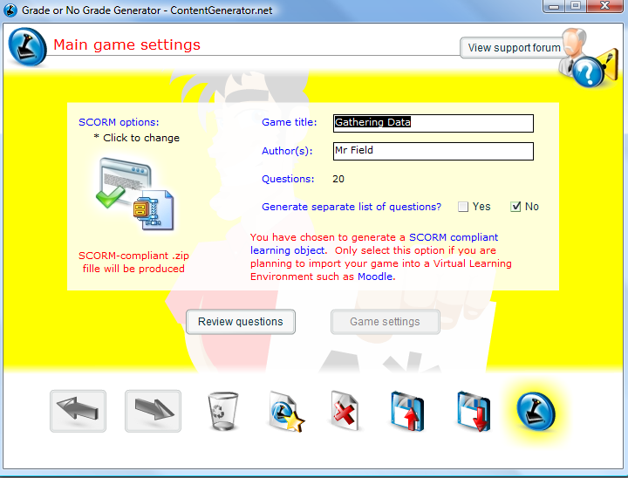

Slide 21


+
+
+
Trackable interactive elements
Change the way you use Moodle
Ideal outside of ‘classroom’

Slide 22
+
+
+
Higher level + more open
Tool for learning
Extending good practice

Slide 23
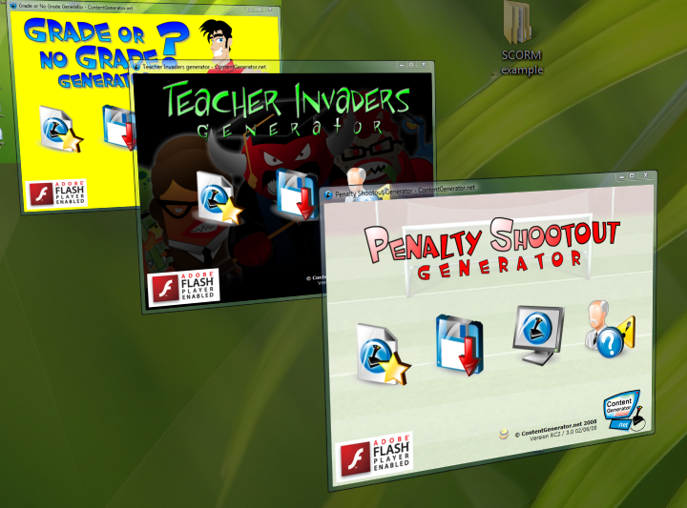

Slide 24
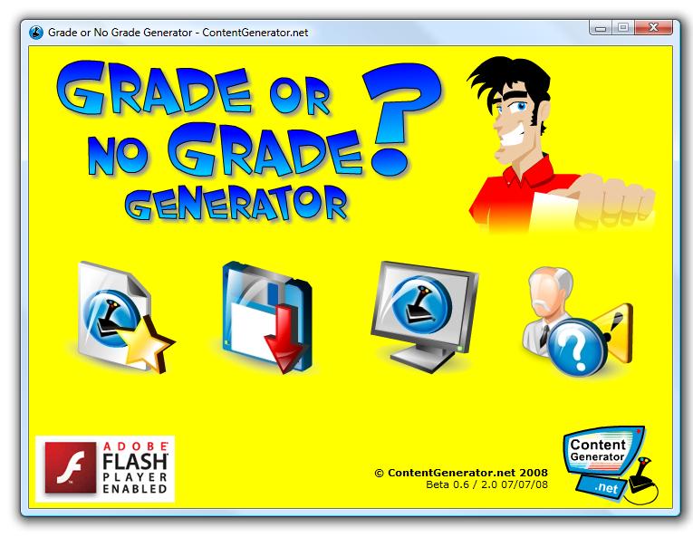

Slide 25
+
+
+
Why bother?
  Live scoreboard in class
  Trackable homework
  Great personalised AFL tool
  Retains visual impact but with added value

Slide 26
+
+
+
Workshop will give you a chance to generate your own SCORM activities

Slide 27
+
+
+
    Explore +ve & -ves of SCORM
    Use the software
    Upload to CambsMoodle
    See the benefits in action

Slide 28
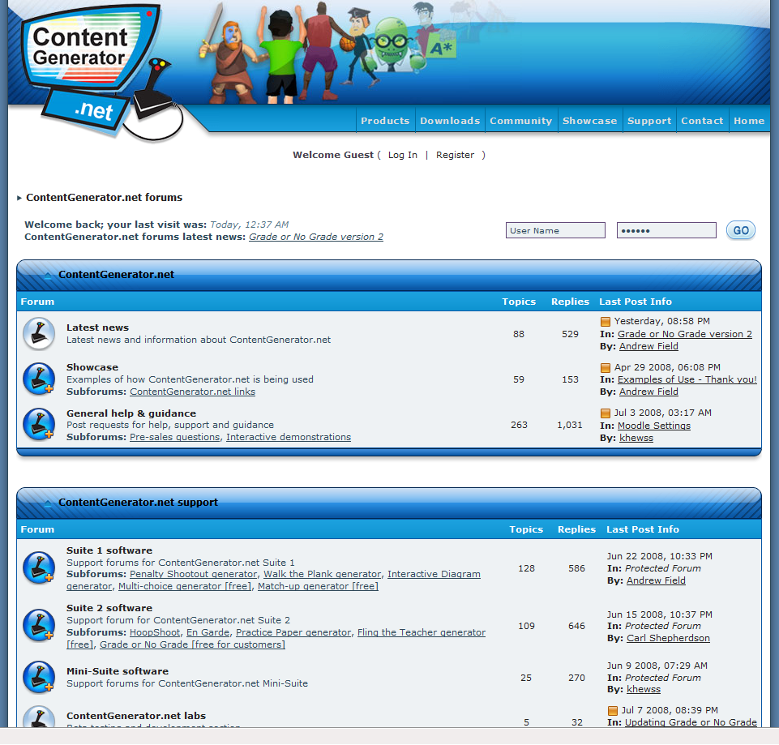
ContentGenerator.net/forum

Slide 29

Using ContentGenerator.net for enjoyable, automatic assessment in Moodle

